Slide 1
On Denoting
Written by Bertrand Russell, presented by Yining Li (School of Life and Science)

Slide 2

Contents
Foundation
Analyzation
Basic knowledge to know before engaging in Russell’s work.
P479-P480
Meaning & Denotation.
Explanation of the Wavery Problem.
Excurses & Expansion: Russell’s theory of analysis of descriptions.
P486-491
04
01
Interpretation
All, some, a, no, every, the.
P481-P482
02
Conclusion
05
Interpretation of definitions in maths.
Importance of identity.
Immediate acquaintance vs define by denoting.
P491-493
03
Problems
Meinong’s and Frege’s systems are NOT perfect. Generally speaking, there are three problems that will pop out when using them.P482,483&485

Slide 3
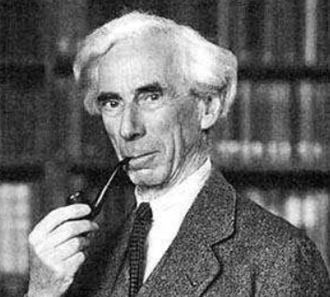
Foundation
What is a “denoting phrase”?
What are the differences between these denoting phrases?
(1) A phrase may be denoting,
and yet not denote anything; e.g., "the present King of France ”(2) A phrase may denote one definite object; e.g., "the present King of England " denotes a certain man. (3) A phrase may denote ambiguously; e.g., " a man " denotes not many men, but an ambiguous man.
“ I mean a phrase such as any one
of the following: a man, some man, any man, every man, all men,
the present King of England,
the present King of France,
the centre of mass of the Solar System at the first instant of the twentieth century,
the revolution of the earth round the sun, the revolution of the sun round the earth.”-On Denoting, Russell, P479

Slide 4
Foundation
The operator operates a variable, conveying certain meaning and ideas.
X, y, z and C(used in the following analysis).
A propositional function
Notion of variable
An unbreakable format
C(x) is always true.
C(x) is always false.(Can be deduced from “C(x) is always false” is always true)
How did Russell construct a proposition?
Notes:
Why is the second one called a “function”? Take p(x) as an example: we must first interpret the denoting phrase “x”, then to substitute all the occurrence of “x” in that proposition, so it would be convenient if we consider the proposition as a function of x.

Slide 5
Interpretation
存在量词被分析掉了
Take x=“ d man/men”, where the determiner d can be “all”, “no”, “some”, “a”, “every”.
C(all men)=“If x is human, then C (x) is true’ is always true”.
C(no men)=“If x is human, then C (x) is false’ is always true”.
C(some men)=C(a man)=“It is false that ‘ C (x) and x is human’ is always false”=“‘C (x) and x is human’ is always false’ is always false”.
C(every man)=C(all men).
What about C(the man)/C(that man)?

Slide 6
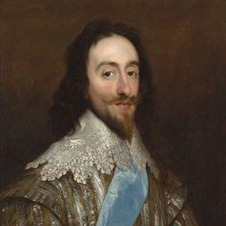
Interpretation：the
No body cares about me?☹
Let’s say, “The father of Charles II has been executed”.
Russell separates “the father” in two parts: first, it asserts that there is an entity that satisfy the description “begat Charles II”; then, it states that there is only one entity, involving uniqueness.
Uniqueness(or identity as mentioned below), is translated into: nothing else has the relation with Charles II, or we can say:
“There exists an x that x begat Charles II, and if y begat Charles II, then y is identical to x.” “There exist” can be formally converted to “It is not always false that…”.
Then we should expand this procedure to an arbitrary proposition C that involves x, where x is “the father of Charles II”. Substitution will eventually go like this: x occurs in the proposition C(x) means:
"It is not always false of x that ' if y begat Charles II., y is identical with x' is always true of y.”

Slide 7
Problems
Meinong: when confronted with a null denotation, we must first presume that the denotation actually denotes something.
Russell is very frustrated with Meinong’s theory: “ Any theory can be found to avoid this result, it is surely to be preferred.”
Frege: Every denoting phrase contains two parts: meaning and denotation.
Russell then checks whether Frege’s theory can stand for the test of three “puzzles”.
Notes:
I overhauled this page and add an additional page (p9) after reading again.

Slide 8
Three interesting puzzles
1. If a is identical with b, there will be no new information inferred when we say “The author of Wavery was Scott”, because the denoting phrase “The author of Wavery” denoted the same person. But this is ridiculous for we all know that when asked “Was Scott the author of Wavery?” by another man who really doesn’t know the answer, you can’t interpret the sentence as “Was Scott Scott?”.
2. By the law of excluded middle, either "A is B " or "A is not B" must be true. Hence either "the present King of France is bald " or " the present King of France is not bald" must be true. Yet if we enumerated the things that are bald, and then the things that are not bald, we should not find the present King of France in either list. So the ways of analyzing by enumerating must be wrong.
3.How can a non-entity be the subject of a proposition? Consider the proposition " A differs from B”, if it is false that A differs from B, then there is no difference between A and B, which fact may be expressed in the form " the difference between A and B does not subsist. Hence, it would appear, it must always be self-contradictory to deny the being of anything; but we have seen, in connexion with Meinong, that to admit being also sometimes leads to contradiction.

Slide 9
Frege’s solution: George IV wanted to know…
As Russell wrote: “One advantage of this distinction is that it shows why it is often worth while to assert identity. If we say " Scott is the author of Waverley," we assert an identity of denotation with a difference of meaning”
According to Frege, the denoting phrase “the author of Waverley” in the sentence “George IV wanted to know who was the author of Waverley” has a different meaning with “Scott”. Thus the first puzzle is feasibly demonstrated: the difference between “the author of Waverley” and “Scott” is the meaning.
Russel then points out, “One of the first difficulties that confronts us… concerns the cases in which the denotation appears to be absent”. Frege’s system can’t perfectly determine the truth value of the proposition like “king of France is not bald”-it is the denoting of “king of France” that we are considering, not the meaning, hence leading to confusion.(Because the king of France is a null class that denotes nobody)
Notes:
Russell does not satisfy with the solution given by Frege, for his system cannot resolve the remaining two puzzles.
Russell’s final goal is to develop an advanced analyzing system, where denoting phrases can be diminished, thus the puzzle of null denotation, as well as the puzzle of excluded middle, can be resolved.

Slide 10
Russell’s final goal
A denoting phrase doesn’t have a meaning of its own-“According to the view which I advocate, a denoting phrase is essentially part of a sentence, and does not, like most single words, have any significance on its own account”
Simple words can have meaning, like “author”, “elegy”, “king”, etc. But a denoting phrase, when considered in an independent and isolated condition, has simply no meaning according to Russell.
To illustrate what does the denoting phrase “the author of Wavery” actually means, Russell puts it in a proposition M(x), where M stands for “is a man”.
By using the interpreting system he introduced, “the author of Waverley” in the proposition “the author of Waverley is a man” can be translated to “One and only one entity wrote Waverley, and that one was a man".
The same can be done for “the king of France”. Now we solve the third puzzle by getting rid of the denoting phrases.
Notes:
To begin with, let’s see what Russell concludes from analyzing the denoting phrase “the first line of Gray‘s Elegy”。很显然，这一页的内容可以解决“指称对象不存在”的问题——我都把指称给翻译没了，指称对象存不存在就根本不重要了。
一般词语，我们都可以在现实中找到对应的entity
This is the idea of reduction- since we cannot mention the meaning of an isolated denoting phrase, why can’t we just abandon it?

Slide 11
Russell’s final goal
Now we can handle the affirmative propositions like “the king of France IS bald” by replacing “there is an x that x is king of France, and that if y is also king of France then y is identical to x” for “the King of France”. And we can easily figure out that this proposition is false.(because the constituent “there exists an x that x is king of France” is false)
But considering the rule of excluded middle, either “the king of France is bald” or “the king of France is not bold” is true. The latter one must be true though it looks weird. How are we supposed to interpret the negative propositions?
That is, where are we supposed to add the negation “not”?
So, this is a problem concerning the scope that a denoting phrase can dominate.
Notes:
To conserve the rule of excluded middle is an attempt on trying to get rid of the ambiguity of natural language, which is very useful in large language models nowadays.(Because a computer only has two digits 1 and 0)

Slide 12
Russel’s final goal
He first separates the occurrence of the denoting phrases in two modes: the primary occurrence and the secondary occurrence.
Primary occurrence dominants a “broad” context, and the secondary one dominants a “thin” context. To return to George IV. and Waverley, when we say, "George IV. wished to know whether Scott was the author of Waverley," we normally mean " George IV. wished to know whether one and only one man wrote Waverley and Scott was that man"; but we may also mean: "One and only one man wrote Waverley, and George IV. wished to know whether Scott was that man “.The latter is under the condition of “One and only one man wrote Waverley”, so it’s broader and by definition, it’s the primary occurrence.
Now adding negation to the primary occurrence: “One and only one man wrote Waverley, and George IV. DIDN’T wish to know whether Scott was that man”, while adding negation to the secondary occurrence appears like: “George IV. wished to know whether IT WAS NOT THE CASE THAT one and only one man wrote Waverley and Scott was that man”. Apparently, we normally interpret the negative sentence as the secondary occurrence form.

Slide 13
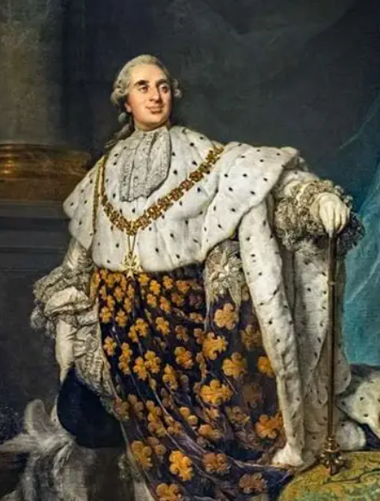
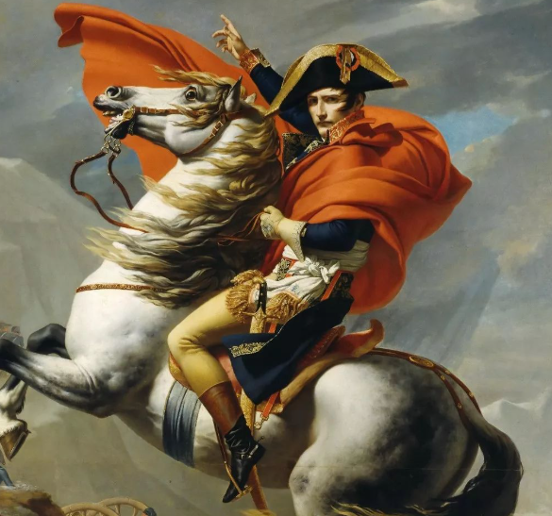
“The king of France” problem
Aww… my head hurts
The condition is simple when the proposition is “The king of France IS bald”. Russell translated this proposition to ∃x [ (K(x) ∧ ∀y(K(y) → y=x)) ∧ B(x) ], where K(x) stands for x is the king of France, B(x) stands for x is bald.
It’s a simple task to decide whether this proposition is true: K(x), B(x) are all atomic propositions that can be evaluated. So because ∃x K(x) is false, the whole proposition is false.
If we put “king of France” in the primary occurence, the proposition “The king of France IS NOT bald” is translated to ∃x [ (K(x) ∧ ∀y(K(y) → y=x)) ∧ ¬B(x) ]. The description “NOT” is IN the range of “king of France”.
If we put “king of France” in the secondary occurence, the propositin “The king of France IS NOT bald” is translated to ¬ ∃x [ (K(x) ∧ ∀y(K(y) → y=x)) ∧ B(x) ]. The description “NOT” is OUT the range of “king of France”.
In the first case, the proposition is false for the same reason as discussed above, but in the second case the proposition is TRUE. Thst’s where the rule of excluded middle still exists!
Do I really look like bald?
Notes:
I’m going to use the presentation of first predicate logic to demonstrate what Russell is advocating. Recall what we’ve just learnt 2 weeks ago.

Slide 14
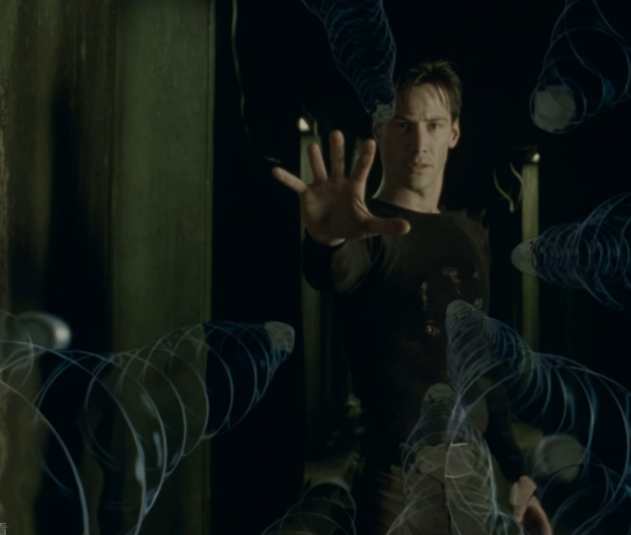
Conclusions
Interpretation of definitions in math: " m-n means the number which, added to n, gives m.”—Seemingly m-n has a meaning in isolation.(3-2 means 1 for example). But we agreed denoting phrases don’t have a meaning in isolation, so an explanation given by Russell is: " Any proposition containing m-n is to mean the proposition which results from substituting for 'm-n' the number which, added to n, gives m.” But we often do this substituting unconsciously.
The usefulness of identity. We introduced identity when interpreting “the”. Furthermore, identity played a significant role in substitution. As Russell wrote, “It is in this way that identity enters into " Scott is the author of Waverley"; and it is owing to such uses that identity is worth affirming.”
Immediate acquaintance vs define by denoting— where do knowledge come from?
In the Matrix, Neo can stop the bullet just by understanding the code of it-know by another kind of denoting(the programed code inside the Matrix).

Slide 15
Thanks for Listening

